Slide 1




COMPARATIVE STUDY
OF ACCIDENT EXPERIENCED AND ACCIDENT-FREE INDIVIDUALS
Presented By:
Mazhar Shaikh - 914
Parth Patil - 926
Shruti More - 910

Slide 2
Overview
1.
Introduction
2.
Objective
3.
Data
4.
EDA
3.
Analysis
4.
Conclusion

Slide 3




Introduction
Road accidents are a pervasive global issue, causing significant loss of life, property damage, and long term physical and emotional challenges. Understanding the behavioral, environmental, and systemic factors influencing accidents is crucial for effective prevention and intervention strategies.
This study examines the key differences between accident-experienced individuals, who provide data based on real-life incidents, and accident-free individuals, who offer opinions on the same scenarios. By employing a parallel survey design for these two groups, the research explores multiple dimensions— driver behavior, road conditions, emergency healthcare response, and mobile phone usage—that contribute to accident occurrence and severity.

Slide 4

Objectives
Identify key factors of Driver Behavior for accidents.
Find relationship between the severity of road accidents and response time of emergency healthcare services.
Study the contribution of mobile phone usage (texting, calls, apps) to accidents among drivers, pedestrians.
Examine how road types influences accident rates.
To identify underlying behavioral, environmental, and vehicular factors contributing to road accident severity.

Slide 5
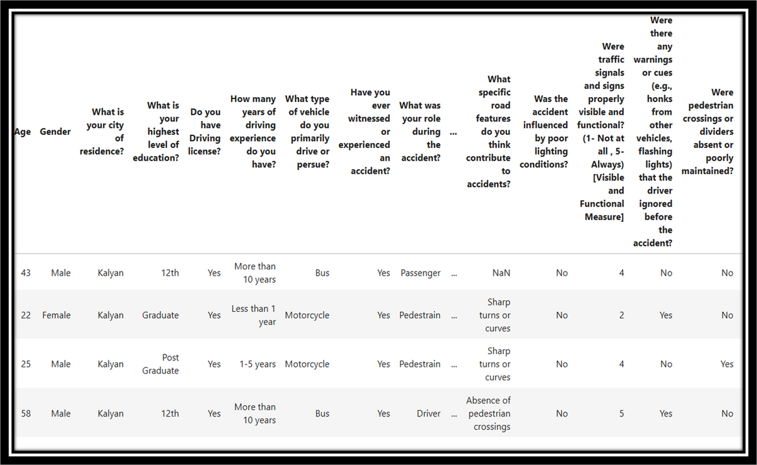
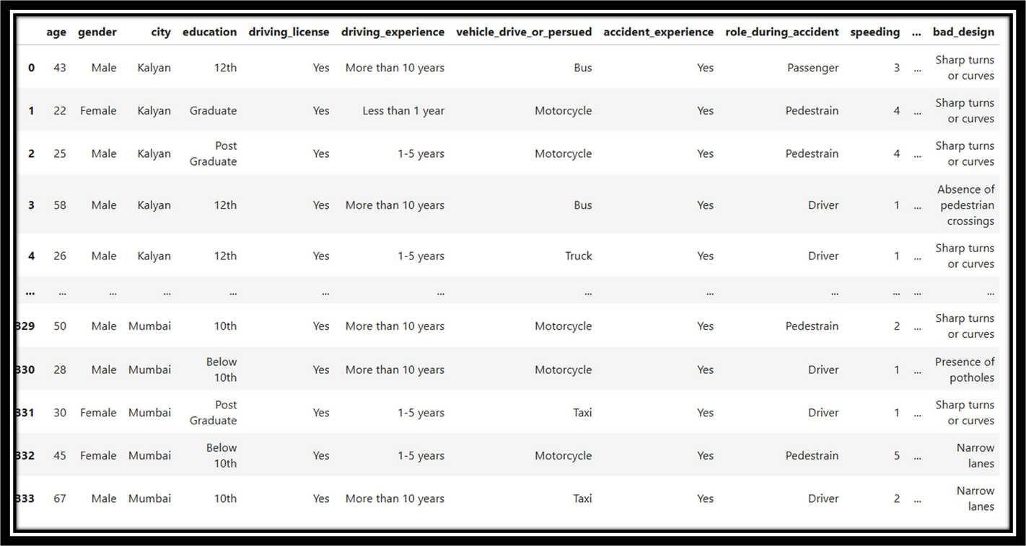
Data

Slide 6
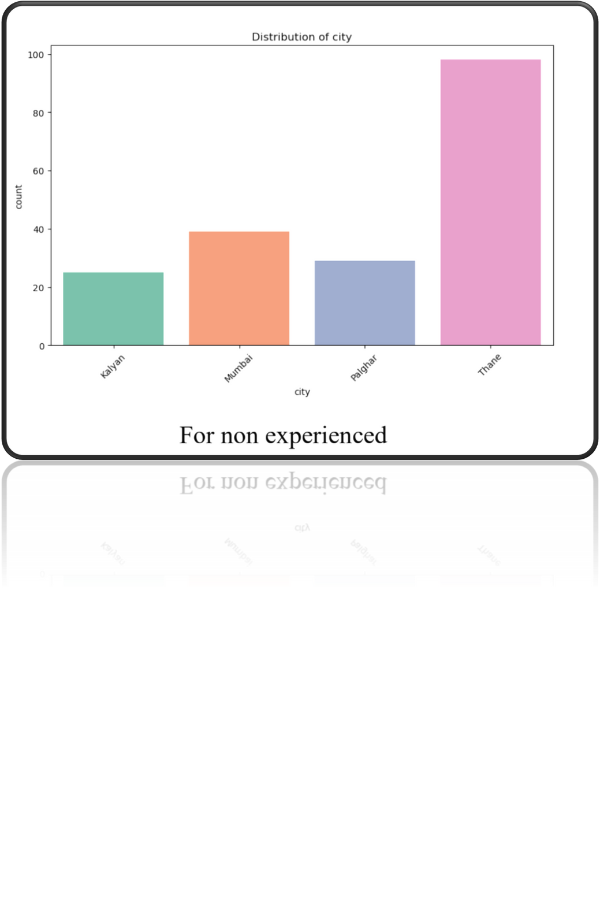
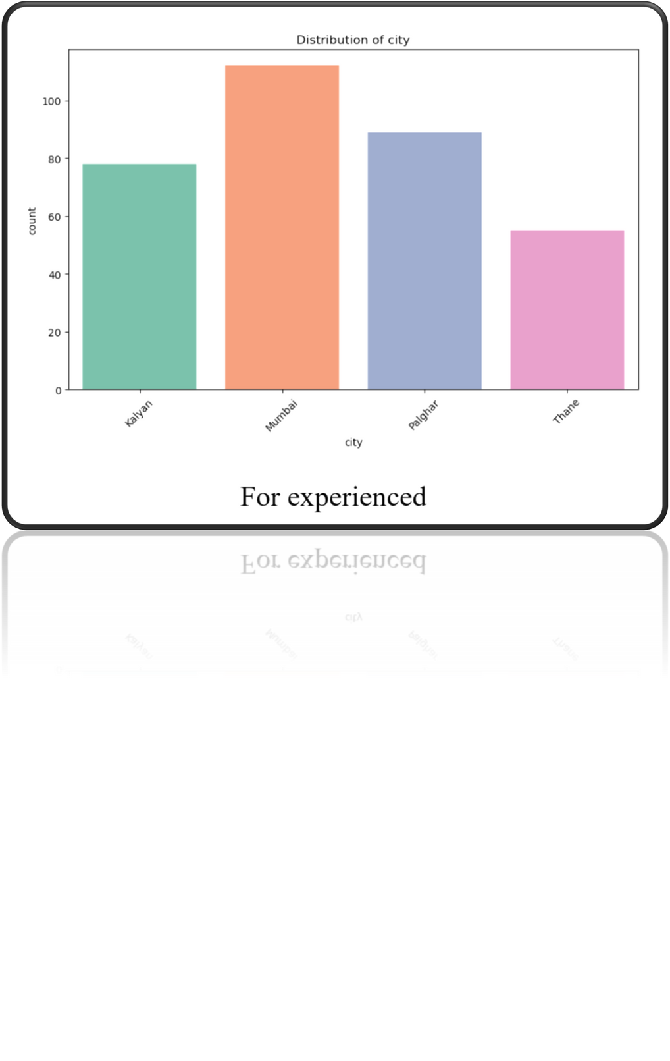
EDA

Slide 7
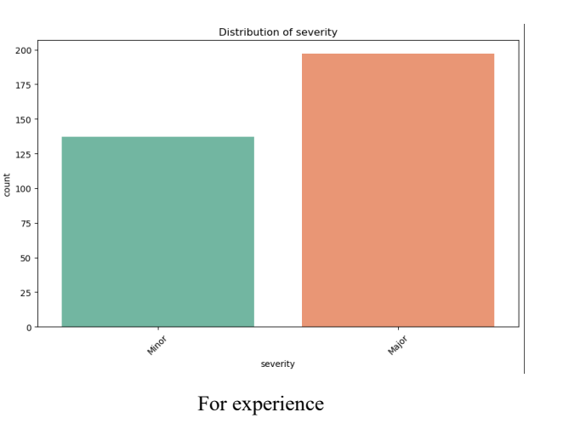
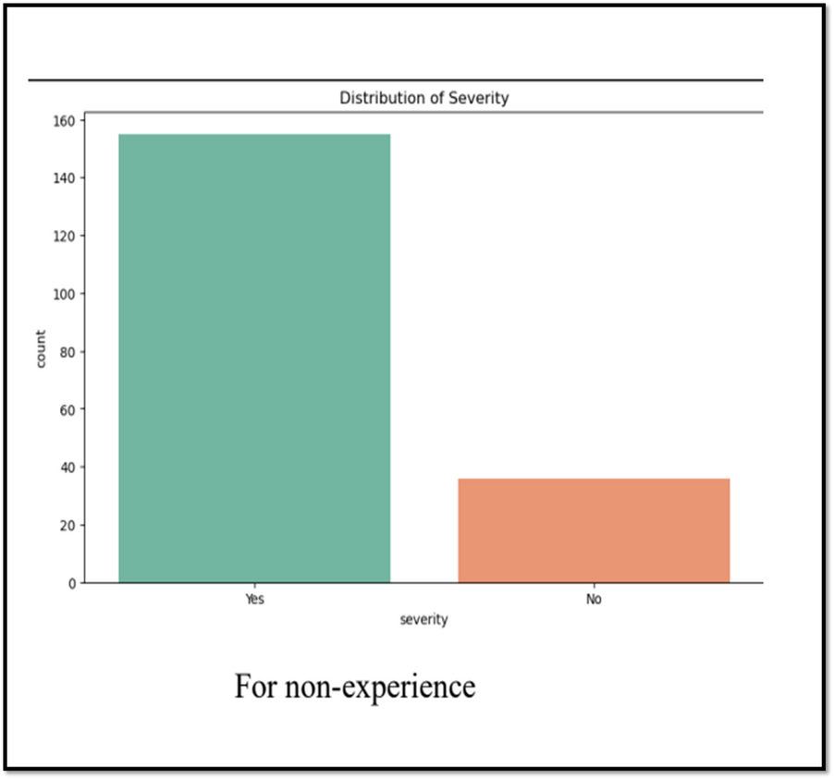
EDA

Slide 8
Identify key factors of Driver Behavior for accidents.
01

Slide 9
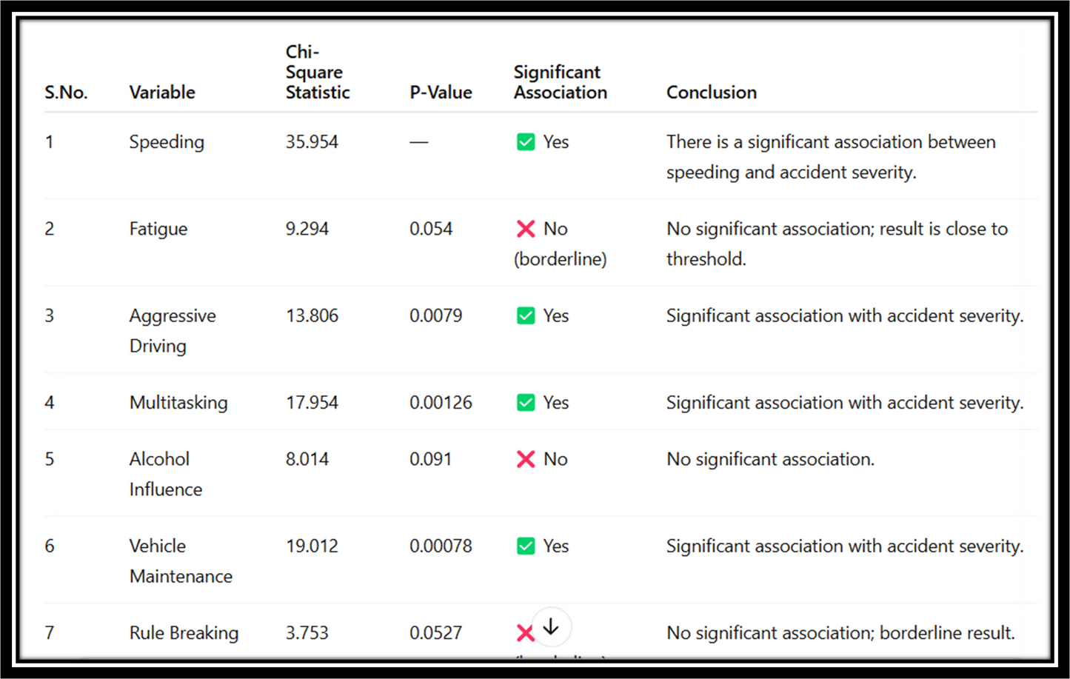
Chi-square test
(For Experienced)

Slide 10
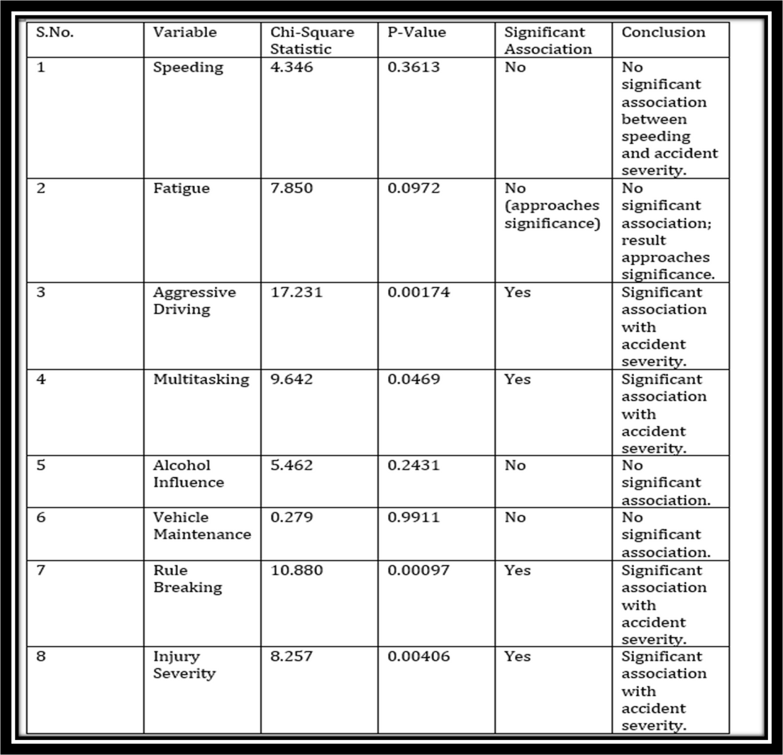
Chi-square test
(For Non-Experienced_

Slide 11

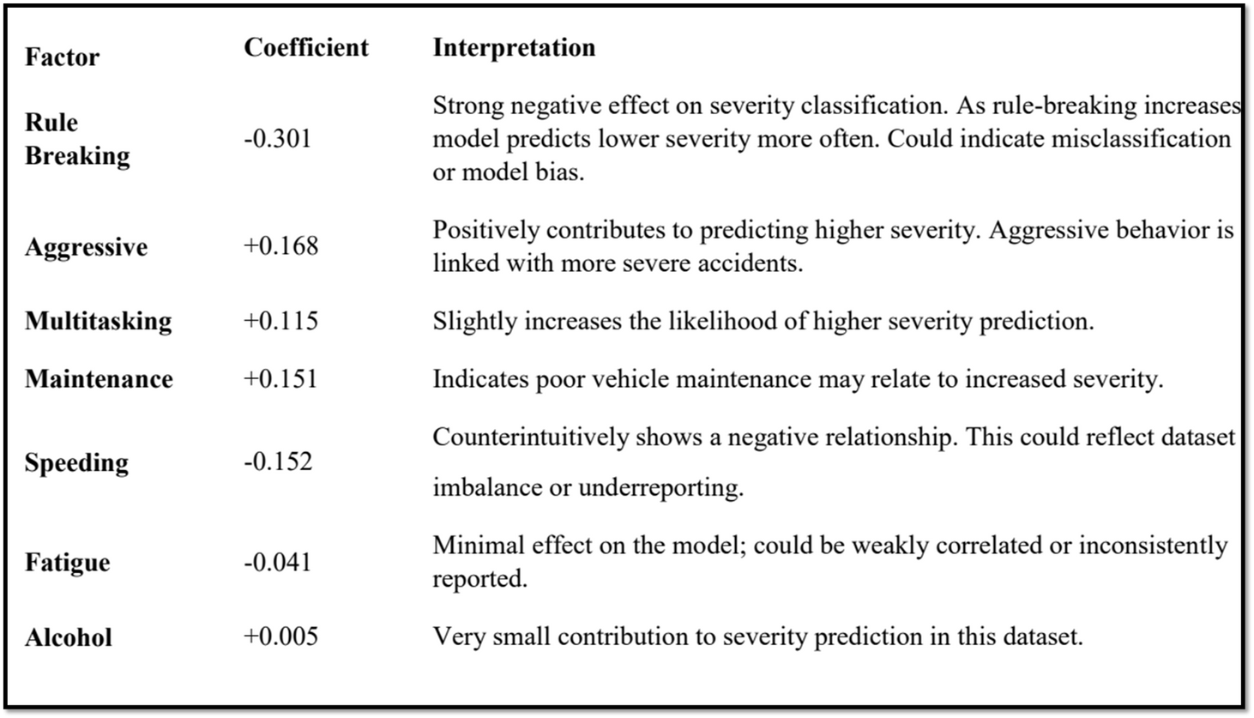
(For Experienced)
Dependent variable –
Y: Severity
Independent variables –
X: speeding ,fatigue ,multitask Alcohol,Rule_Break,Aggressive Maintainence
Logistic
Regression

Slide 12
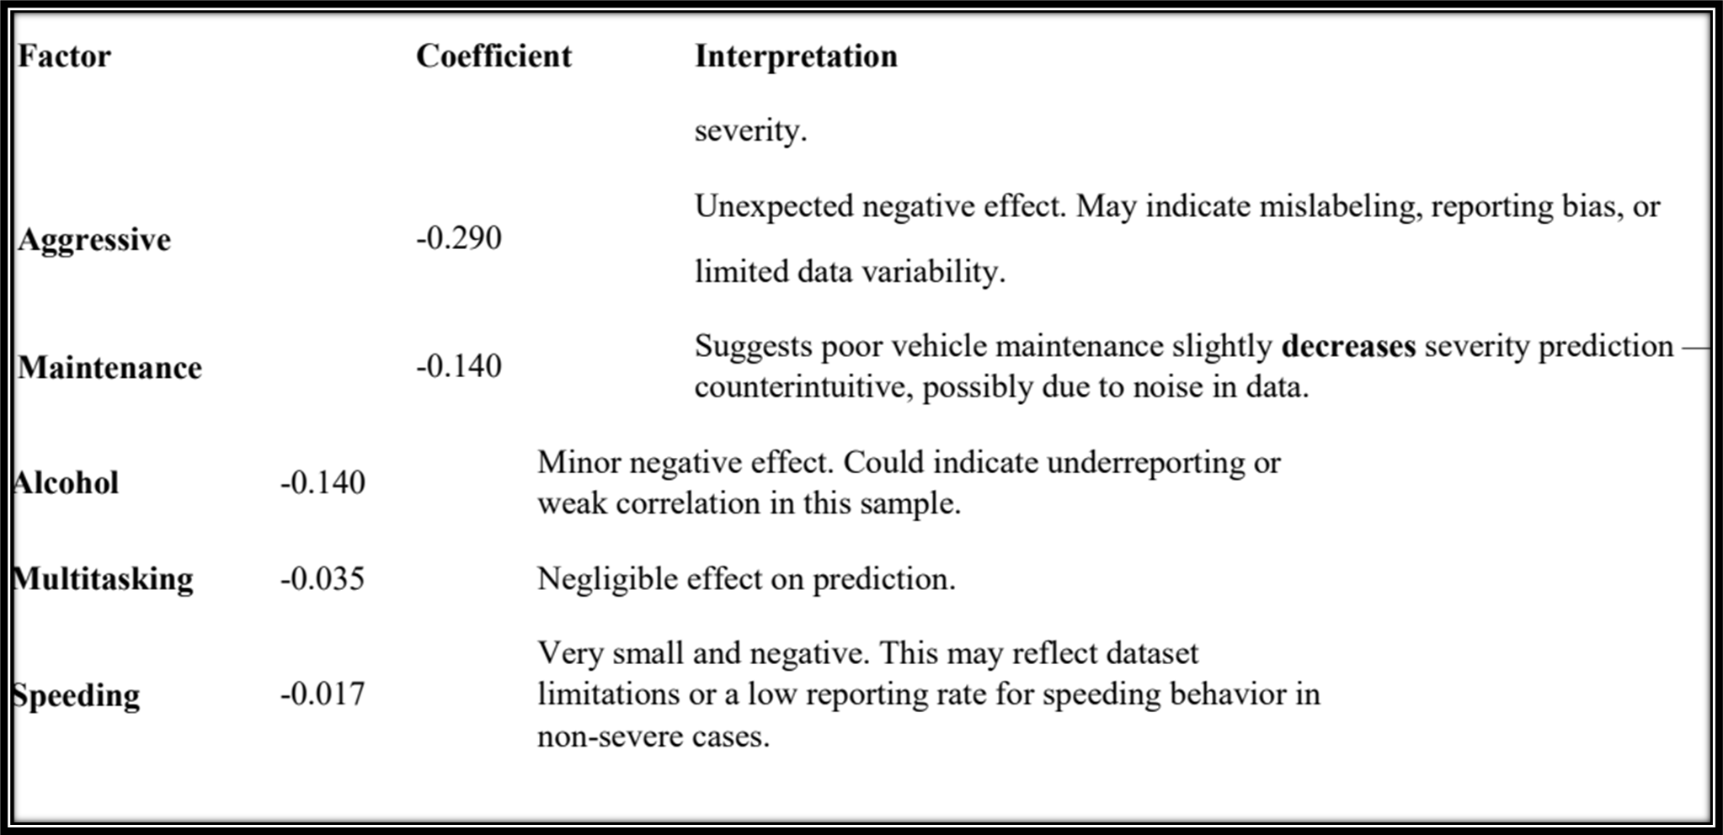
(For Non-Experienced)

Slide 13
Overall Conclusion
Model Overview
A logistic regression model was developed to classify accident severity using behavioral and situational factors. The dataset showed imbalanced class distribution, with 79% of cases labeled as severe and 21% as non-severe.
Model Performance:
Accuracy: 67%
F1 Score:
High Severity (class 1): 0.77 – reasonably strong
Low Severity (class 0): 0.38 – weak, due to poor precision and recall
Recall (class 1): 0.71 – The model is moderately effective in identifying high-severity cases.
Precision (class 1): 0.85 – The model is confident when it predicts high severity.
The model shows moderate effectiveness in predicting accident severity, highlighting aggressive driving, multitasking, and poor maintenance as key risk factors, while unexpected trends in predictors like rule-breaking and speeding suggest the need for deeper data investigation.

Slide 14
To find the relationship between the severity of road accidents and
the response time of emergency healthcare services.
02

Slide 15

Key Variables:
Emergency Time (time taken for help to arrive)
First Aid Provided (Yes/No)
Delay in Injury Recognition or Treatment
Chi-square
test

Slide 16
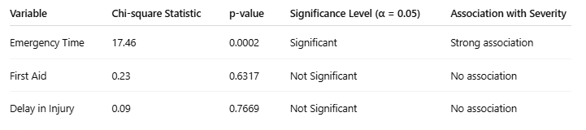
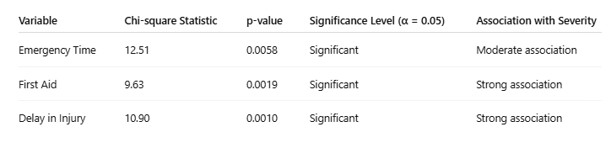

Slide 17
Chi-Square Test – Non-Experienced
Emergency Time, First Aid, Injury Delay: All significant
Conclusion:
All three factors significantly impact severity in non-experienced individuals.
Chi-Square Test – Experienced
Emergency Time: Significant (p = 0.0002)
First Aid & Injury Delay: Not significant
Conclusion:
Faster emergency response reduces accident severity

Slide 18
Experienced:
Emergency Time strongly linked to severity
Non-Experienced:
Delays increase severity
First aid reduces severity
Proportional Analysis

Slide 19
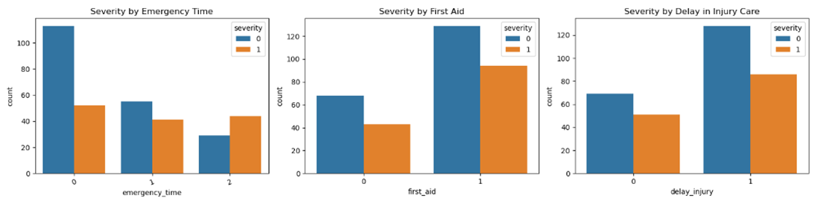
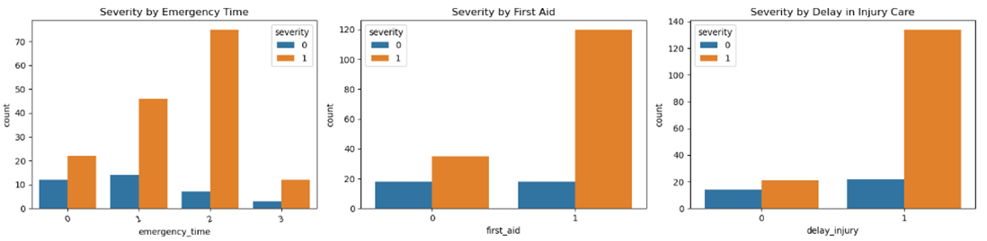

Slide 20
Study the contribution of mobile phone usage to accidents
03

Slide 21
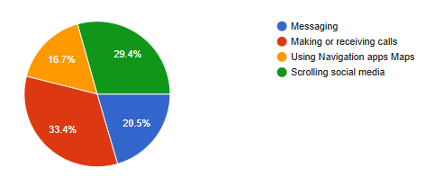
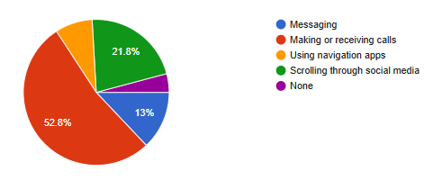
Experienced
Non-Experienced

Slide 22
Apriori Algorithm
Purpose: Find frequent patterns (e.g., phone usage → major accident)
Steps:
One-hot encoding of data , Minimum confidence = 50%
Rules filtered to include phone usage as a condition

Slide 23


For Experienced
For Non-Experienced
Rule 1:
If phone_cause = Yes AND phone_activity = Any
Then Severity = Major
Support: 26.6%, Confidence: 69%, Lift: 1.17
Rule 2:
If phone_cause = Yes → Severity = Major
Confidence: 61%, Lift: 1.04
Insight: Phone activity increases likelihood of major accidents by 17%
No association rules found
Reason:
Insufficient data patterns among non-experienced users

Slide 24
Decision Tree Classifier
Model Input: Phone cause, activity, and user behavior
Target: Accident severity
Tree Depth: 4
Visualizes how phone behavior affects accident outcome

Slide 25
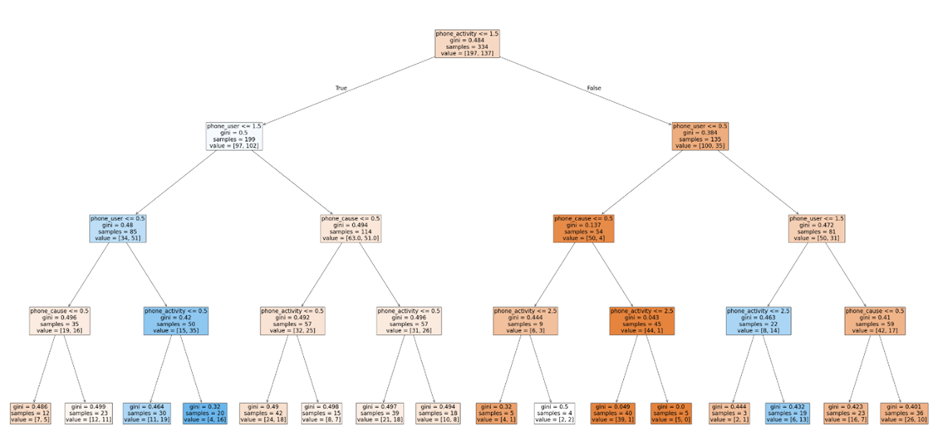

Slide 26
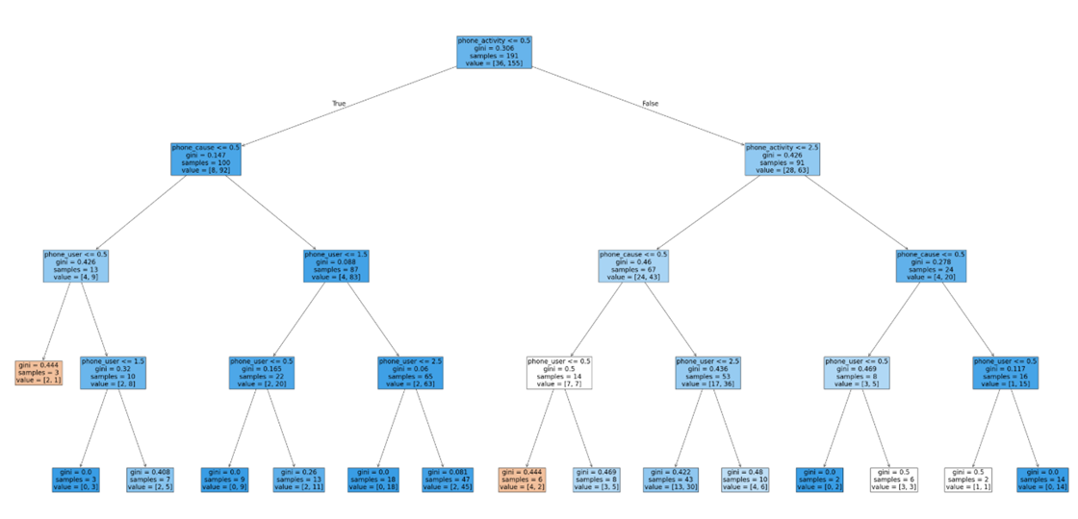

Slide 27
Examine how road conditions influence accident severity
04

Slide 28
XGBoost Classifier (Extreme Gradient Boosting)
Why XGBoost?
High accuracy
Handles missing data
Highlights important features

Slide 29
Dataset Split: 70% Training | 30% Testing
Features Used: bad_road, bad_design, sign_visible, no_crossing, ignored_signs, traffic, location_risk
Classes: 0= Major Accidents , 1 = Minor Accidents
Evaluation Metrics:
Accuracy, Precision, Recall, F1-Score

Slide 30
Experienced Class
Accuracy: 56%
Major Accidents (Class 0):
Precision: 59%, Recall: 72%, F1: 0.65
Minor Accidents (Class 1):
Precision: 50%, Recall: 36%, F1: 0.42
Model detects major accidents better but misclassifies minor ones

Slide 31
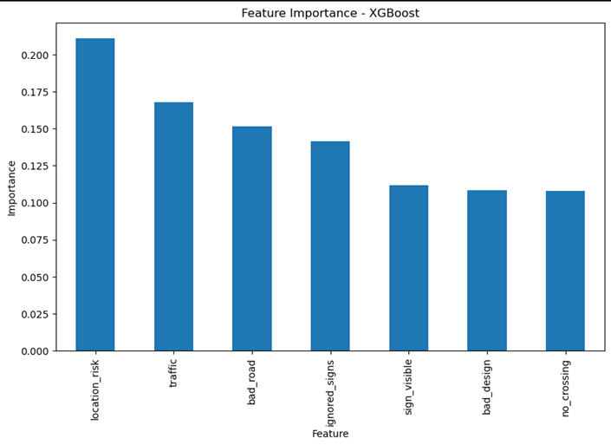
Experienced

Slide 32
Non-Experienced
Accuracy: 79%
Minor Accidents (Class 1):
Precision: 83%, Recall: 94%, F1: 0.88
Major Accidents (Class 0):
Precision: 40%, Recall: 18%, F1: 0.25
Strong model performance for minor cases, poor for major ones

Slide 33
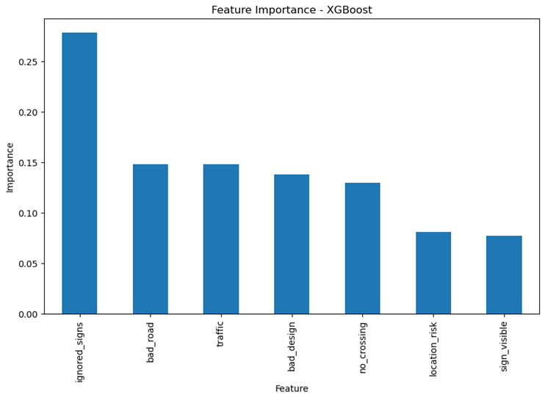
Non- Experienced

Slide 34
To identify underlying behavioral, external, and vehicular factors contributing to road accident severity.
05

Slide 35
Factor
Analysis
Why
Reduces data complexity by grouping related variables into a few underlying factors.
Identifies hidden patterns that explain common behavior or characteristics.
Simplifies analysis and interpretation by focusing on core dimensions instead of individual variables.
Improves modeling and insights by using meaningful factor scores in further statistical analysis.

Slide 36
Features droped
Features selected
'age','gender','city','education', 'driving_license','driving_experience', 'vehicle_drive_or_persued','accident_experience','role_during_accident','long_impact',’low_confidence','changed_behavior','severity'
'speeding', 'fatigue', 'aggressive', 'multitask', 'alcohol','maintainence', 'multi_vehicle', 'safety_used', 'injury_severity','route_known', 'route_familiar', 'vehicle_known', 'vehicle_unfamiliar','brake_or_swerve', 'driver_exp', 'emergency_time', 'first_aid','delay_injury', 'phone_cause', 'phone_user', 'phone_activity',
'location_risk', 'bad_road', 'bad_design', 'bad_light', 'sign_visible', 'ignored_signs', 'no_crossing', 'traffic', 'rule_break'

Slide 37
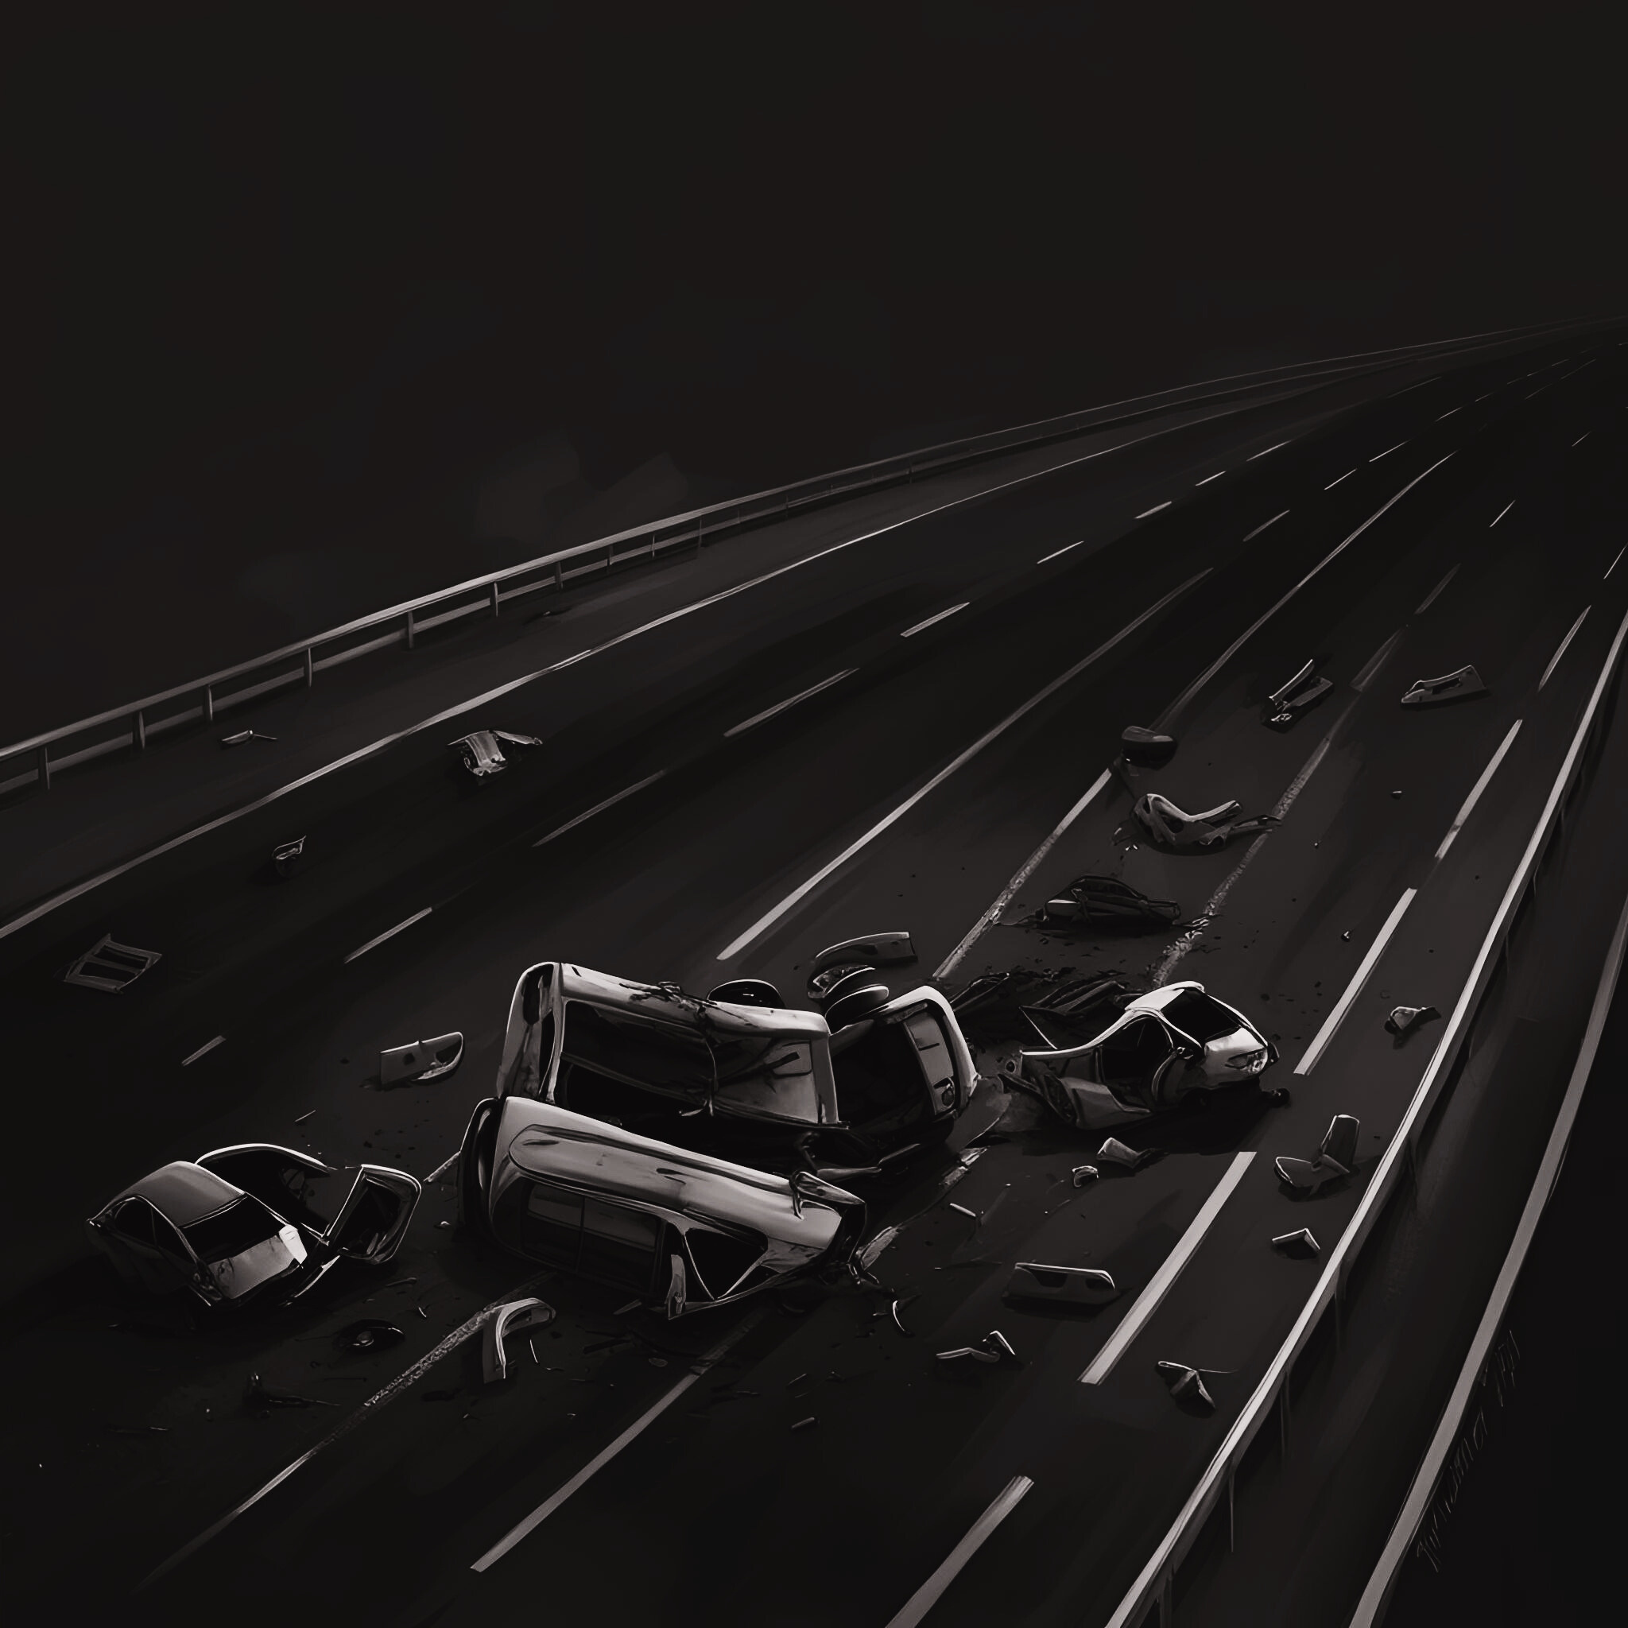

2. Kaiser-Meyer-Olkin (KMO) test
3. Bartlett's test of sphericity
Bartlett's Test checks if a correlation matrix is suitable for factor analysis by testing whether it's significantly different from an identity matrix.
Hypothesis:
H0: Population correlation matrix is an Identity matrix
H1: Population correlation matrix is not an Identity matrix
It assesses the adequacy of data by measuring how much variance among variables is shared.
It helps determine if variables are suitable for identifying underlying factors.
Assumptions
1. Standardization
KMO Score: 0.66
>0.5
Bartlett’s Test
p-value:
1.33 × 10⁻⁶⁷
< 0.05
This step is essential when variables are measured on different scales or units.
standardization scales variables to a mean of 0 and a standard deviation of 1, ensuring equal contribution and focusing on shared variance for comparability.

Slide 38
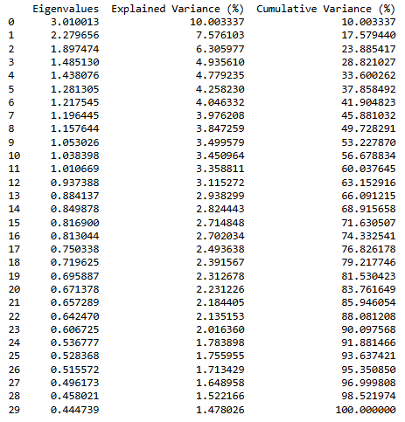
Principal Component Analysis

Slide 39
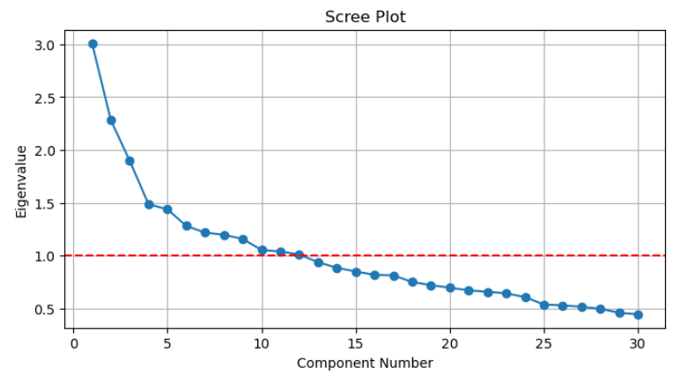

Slide 40
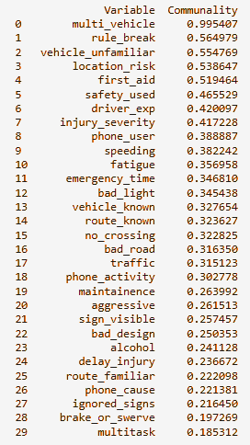
Communality
High communality values indicate that variables contribute significantly to defining the factors, whereas low values suggest lesser importance in explaining the shared variance.

Slide 41
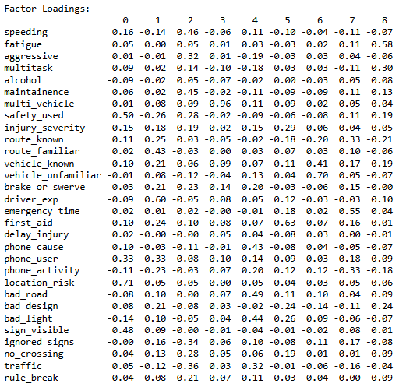
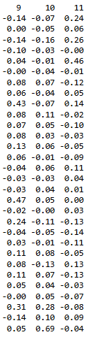
Factor
Loadings
Factor loadings represent the correlation or relationship between the original variables and the extracted components.
A high absolute loading indicates that the variable is strongly associated with that factor.

Slide 42
Based on factor loadings the extracted factors are Environmental Risk Awareness, Driver Familiarity & Focus, Reckless Driving Behavior, Multi-Vehicle Crash Impact, Road & Visibility Hazards, Post-Accident Emergency Response, Vehicle Familiarity Issues, Emergency Accessibility & Navigation, Driver Fatigue & Cognitive Load, Injury Outcomes & Delay Factors, Traffic Law Violation, Substance Use & Aggression.
Factor scores represent the values of the latent factors for each observation in your dataset.
They are calculated based on the factor loadings and the observed data.
Factor scores are useful for interpreting how each observation relates to the underlying factors identified in factor analysis.
Factor scores

Slide 43
Logistic Regression
X = factor score data features
y = severity
Predictive Modeling
Results:
1. Accuracy: The model achieved an overall accuracy of 65%, indicating it correctly classified 65 out of 100 cases.
2. Class-wise Performance:
Class 0 (Major Accidents):
Precision: 75%
Recall: 58%
F1-score: 65%
Class 1 (Minor Accidents):
Precision: 58%
Recall: 75%
F1-score: 65%

Slide 44
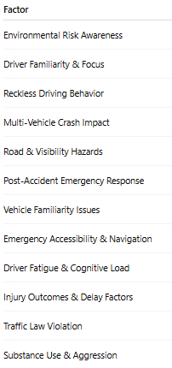
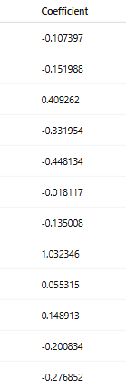
Model Coefficients:
Significant factors influencing the prediction:
Rule-breaking and aggressive behavior showed high positive coefficients, indicating strong associations with major accidents.
Road familiarity and safety measures were moderately linked to minor accident predictions.

Slide 45
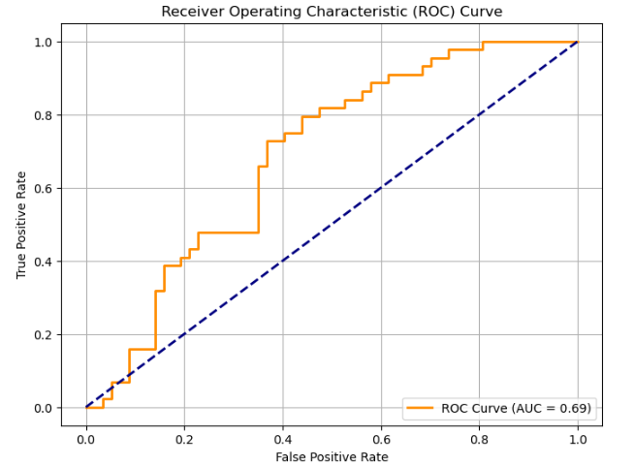

Slide 46
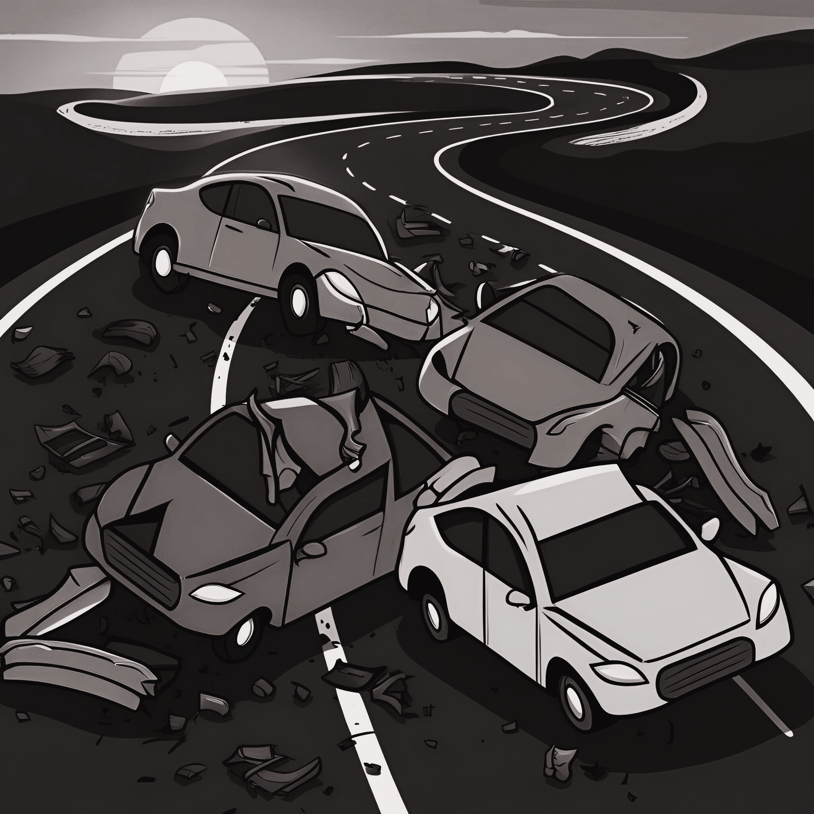
Conclusion
The study provides a comprehensive comparison of accident‐experienced and accident‐free individuals, revealing that driver behavior plays a decisive role in road accident severity. Behavioral factors such as speeding, aggressive driving, and multitasking are strongly associated with higher severity, particularly among experienced drivers.
In contrast, for non‐experienced drivers, situational variables like injury recognition delays and the absence of prompt first aid are more influential.
Emergency response time consistently emerges as a critical factor in reducing accident severity—faster responses correlate with better outcomes across both groups.
Moreover, mobile phone usage while driving, especially involving active engagement (texting, calling), significantly heightens the risk of major accidents.
The use of diverse modeling techniques, including logistic regression, decision trees, XGBoost, and exploratory factor analysis, underscores the multifactorial nature of accident causation and highlights areas where data improvements can further refine predictive performance.

Slide 47
THANKYOU!

